Slide 1


CROSS-BORDER UPDATE
WITH THE ENFORCERS
Recent Marketing Enforcement Trends
in the US, the UK and Canada
Moderator:
Michael Binetti Affleck Greene McMurtry LLP
Panelists:
Lesley Fair Federal Trade Commission
George Lusty Competition and Markets Authority
Nicola Pfeifer Competition Bureau Canada
May 2020

Slide 2
George Lusty doesn’t speak for the Competition and Markets Authority
Nicola Pfeifer
doesn’t speak for the Competition Bureau.
And Lesley Fair doesn’t speak for the FTC.

Slide 3
COVID-19
RESPONSE

Slide 4
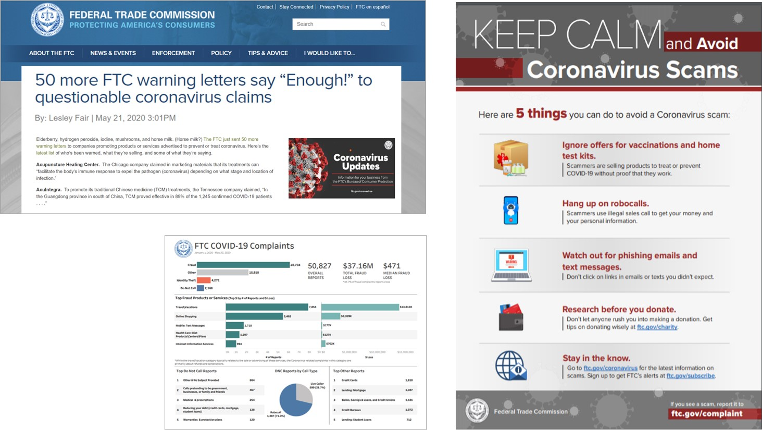
FEDERAL TRADE COMMISSION

Slide 5

FEDERAL TRADE COMMISSION
Whole Leaf Organics (complaint filed)

Slide 6
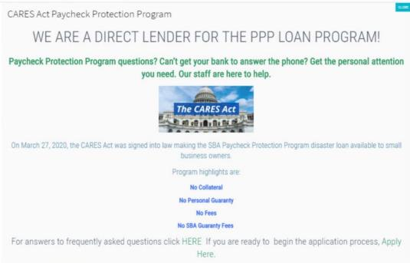

FEDERAL TRADE COMMISSION
FTC v. Ponte Investments, LLC (complaint filed)

Slide 7


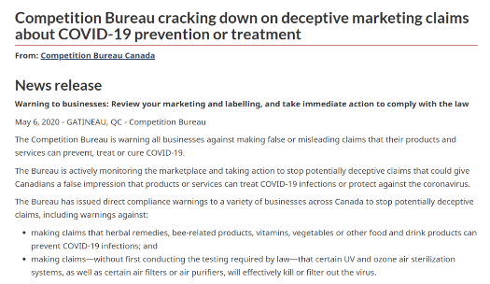
COMPETITION BUREAU
Working with partners
Price gouging provincial
29 letters sent to companies
No approved treatment, no cure, illegitimate tests

Slide 8
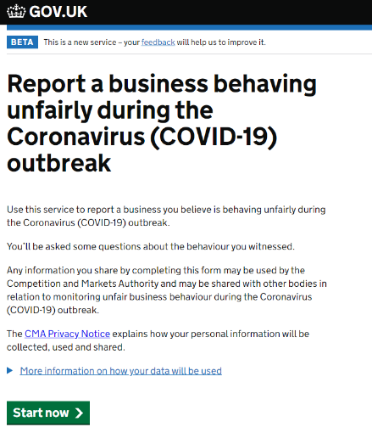
COMPETITION AND MARKETS AUTHORITY

Slide 9



COMPETITION AND MARKETS AUTHORITY

Slide 10
PERFORMANCE
CLAIMS

Slide 11
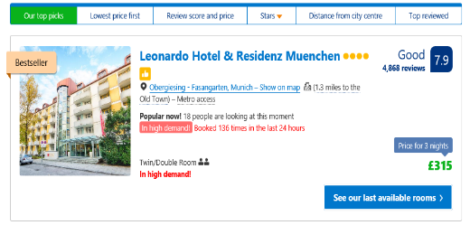

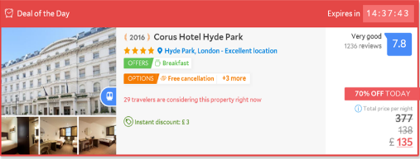

COMPETITION AND MARKETS AUTHORITY
gov.uk/cma-cases/online-hotel-booking
gov.uk/cma-cases/online-gambling

Slide 12


FEDERAL TRADE COMMISSION
Whole Leaf Organics (complaint filed)
FTC v. Renaissance Health Publishing, LLC (stipulated order)

Slide 13


FEDERAL TRADE COMMISSION
Williams-Sonoma, Inc. (proposed consent order)

Slide 14


COMPETITION BUREAU
Deceptive Marketing Practices Digest, vol 2
Adequate and proper testing
  not based on academic studies, high sales
  should reflect real life conditions
14

Slide 15
FINANCIAL HARM
TO CONSUMERS

Slide 16

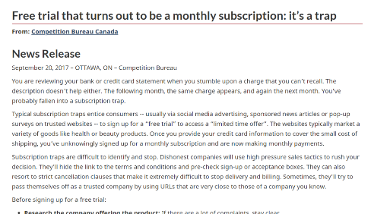
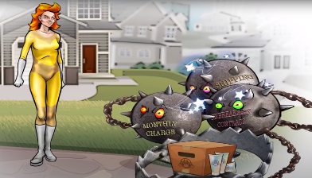
COMPETITION BUREAU
Subscription Traps/Negative Option Billing
“Free trial”
    Full cost
    Monthly billing
    Other products
False or misleading can be the product itself or the billing terms

Slide 17
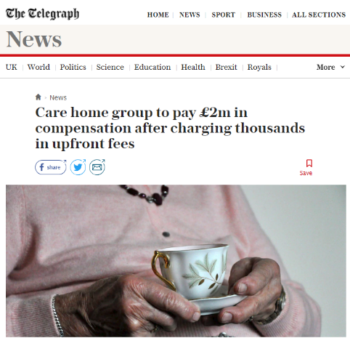
COMPETITION AND MARKETS AUTHORITY
“We were handed the contract on the day that she moved in. When I was able to sit down and read it, perhaps a day later, or that evening, I was astonished to read the term about 2 weeks admin fee.
As the weekly fees were at the time £1,425 per week, this equates to a £2,850 admin fee, which I found staggering, especially given the high weekly cost already.”
gov.uk/cma-cases/care-homes-consumer-protection-case

Slide 18


COMPETITION AND MARKETS AUTHORITY
gov.uk/cma-cases/leasehold
gov.uk/cma-cases/self-funded-ivf-consumer-law-guidance

Slide 19

FEDERAL TRADE COMMISSION
$191 million
judgment
FTC v. The University of Phoenix (stipulated order)

Slide 20

FEDERAL TRADE COMMISSION
$172 million
judgment
FTC v. The University of Phoenix (stipulated order)

Slide 21

FEDERAL TRADE COMMISSION
$9 million
civil penalty
FTC v. The University of Phoenix (stipulated order)

Slide 22
SOCIAL MEDIA
and INFLUENCERS

Slide 23
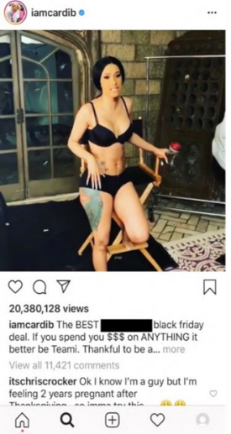

FEDERAL TRADE COMMISSION
Teami (consent order)

Slide 24

FEDERAL TRADE COMMISSION
I would like everyone to create 3 accounts on Sephora.com, registered as a different identities. This is how you do it:
Create a new persona. Choose their name, city, skin type.
Setup a new email on gmail
Before going onto Sephora.com, clear your cookie history EACH TIME …
Connect to the internet ONLY using the VPN. Make sure to choose a city of origin that goes along with where your character lives.
Leave a review – make sure to NOT compare the product to other products, to not use foul language, and to be very enthusiastic without looking like a plant. Always leave 5 stars.
Review a few other products as well – no skincare. Only review makeup, color, hair.
Leave a review for a different product every other day so you build up history. You can also use this identity on Beauty Board.
You will need to clear cookies and use the VPN every time, or your account will be flagged.
The other thing, if you see a negative review – DISLIKE it. After enough dislikes, it is removed. This directly translates to sales!!
Sunday Riley (proposed consent order)

Slide 25
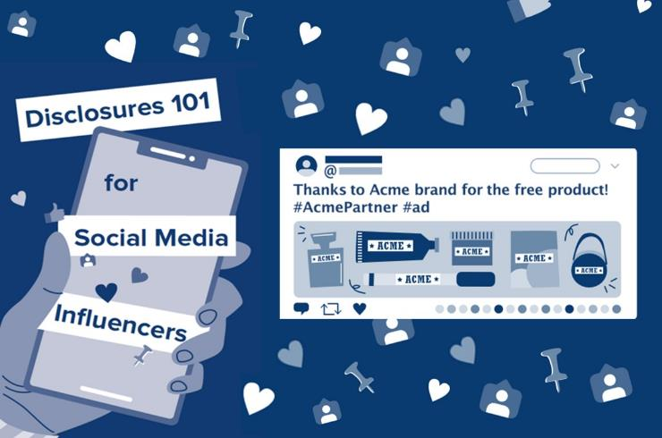
FEDERAL TRADE COMMISSION
available at business.ftc.gov

Slide 26
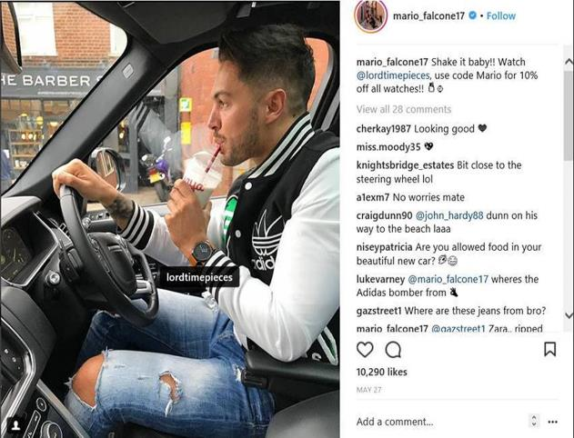
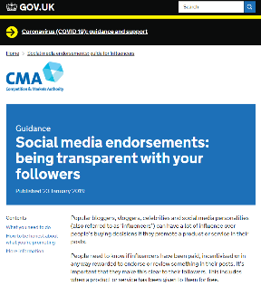
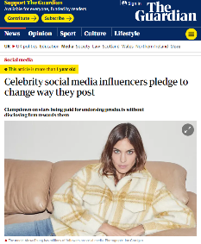
COMPETITION AND MARKETS AUTHORITY
gov.uk/cma-cases/social-media-endorsements

Slide 27
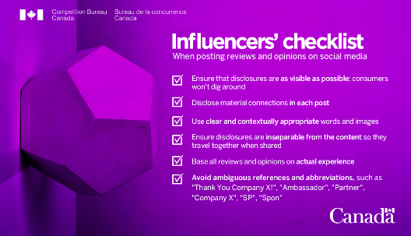
COMPETITION BUREAU
Must disclose all material connections
$, free products, discounts, personal relationships

Slide 28


COMPETITION BUREAU
Deceptive Marketing Practices Digest – vol 4
Letters to 100 brands and marketing companies: health, beauty, fashion, technology, travel

Slide 29
CONSUMER
REVIEWS

Slide 30


COMPETITION BUREAU
Authentic experiences of consumers: Independent, impartial
The business of reviews
Deceptive Marketing Practices Digest, vol 1

Slide 31


COMPETITION BUREAU
Signs of Astroturfing
  recent user profile, lots of positive feedback, handful of products over a short period of time
  “the best thing ever”
How would you write a review?

Slide 32
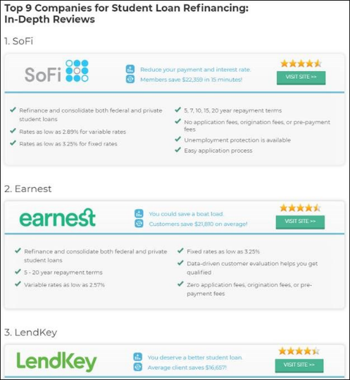
FEDERAL TRADE COMMISSION
LendEDU (consent order)

Slide 33
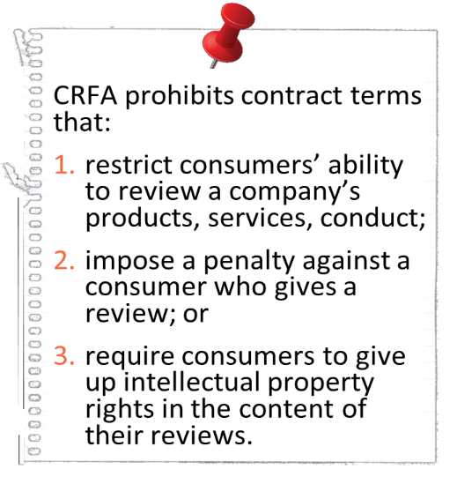
FEDERAL TRADE COMMISSION
CONSUMER
REVIEW
FAIRNESS
ACT

Slide 34
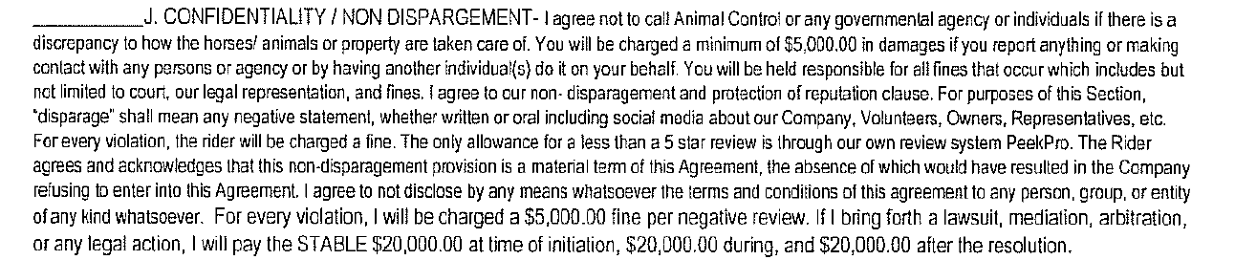
FEDERAL TRADE COMMISSION
I agree not to call Animal Control or any government agency or individuals if there is a discrepancy to how the horses/animals or property are taken care of. You will be charged a minimum of $5,000 in damages if you report anything or make contact with any person or agency or by having another individual do it on your behalf. . . .
I agree to not disclose by any means whatsoever the terms and conditions of this agreement to any person, group, or entity of any kind whatsoever. For every violation, I will be charged a $5,000 fine . . . .
In the Matter of LVTR, LLC (consent order)

Slide 35

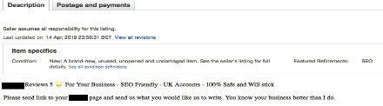
COMPETITION AND MARKETS AUTHORITY
gov.uk/cma-cases/fake-and-misleading-online-reviews

Slide 36
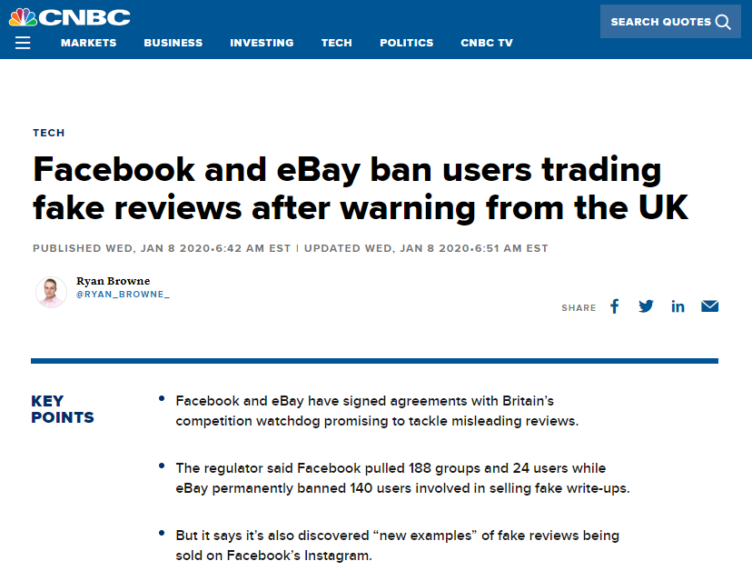
COMPETITION AND MARKETS AUTHORITY
gov.uk/cma-cases/fake-and-misleading-online-reviews

Slide 37
PLATFORM
ISSUES

Slide 38
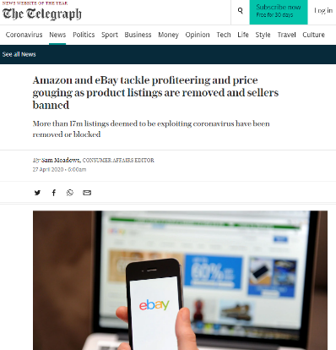
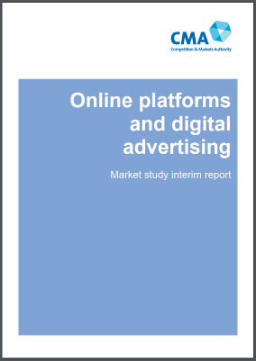
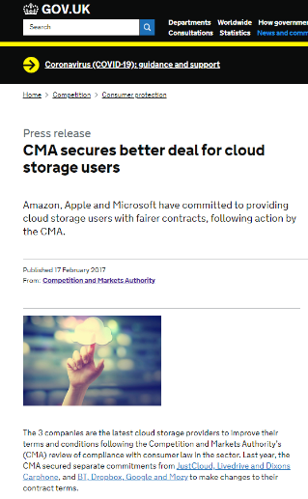
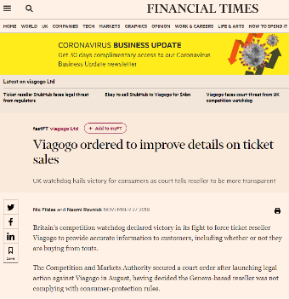
COMPETITION AND MARKETS AUTHORITY

Slide 39
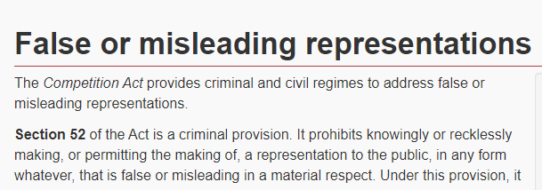


COMPETITION BUREAU
Permitting a representation to be made – s 52(1.2)
Criminal and civil
The facts…

Slide 40

FEDERAL TRADE COMMISSION
DEPENDING
ON THE
FACTS
FTC ACT
advertisers
retailers
advertising agencies
endorsers and influencers
home shopping channel
catalog companies
social media sites
individual corporate offices
certain platforms

Slide 41
PRIVACY and
DATA SECURITY

Slide 42
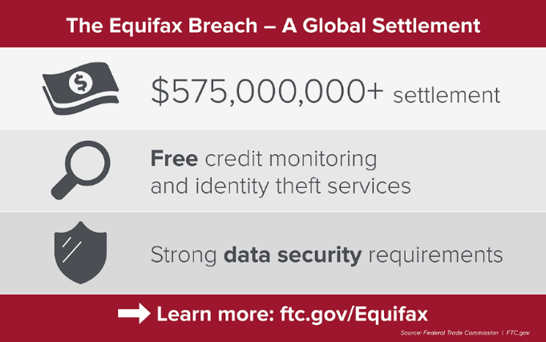
FEDERAL TRADE COMMISSION
FTC v. Equifax, Inc. (stipulated order)

Slide 43

FEDERAL TRADE COMMISSION
$170 million
civil penalty
FTC and State of New York v. Google LLC and YouTube LLC (stipulated order)

Slide 44

FEDERAL TRADE COMMISSION
$5 billion
civil penalty
FTC v. Facebook (stipulated order)

Slide 45


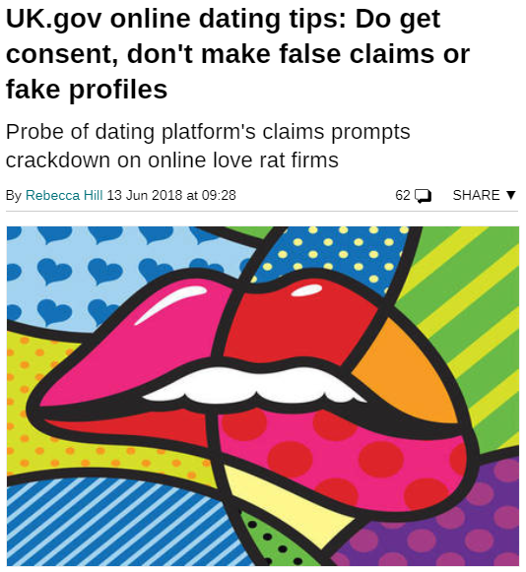
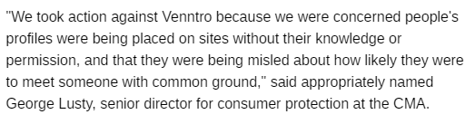
COMPETITION AND MARKETS AUTHORITY
45
gov.uk/cma-cases/online-dating-services

Slide 46
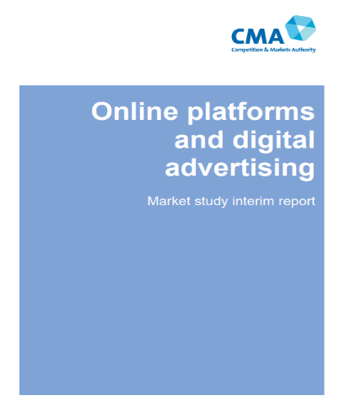
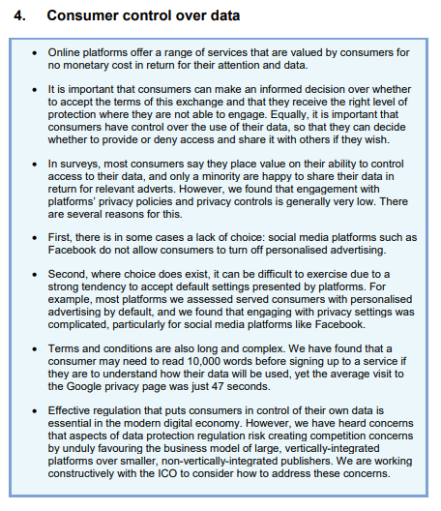
COMPETITION AND MARKETS AUTHORITY
gov.uk/cma-cases/online-platforms-and-digital-advertising-market-study

Slide 47
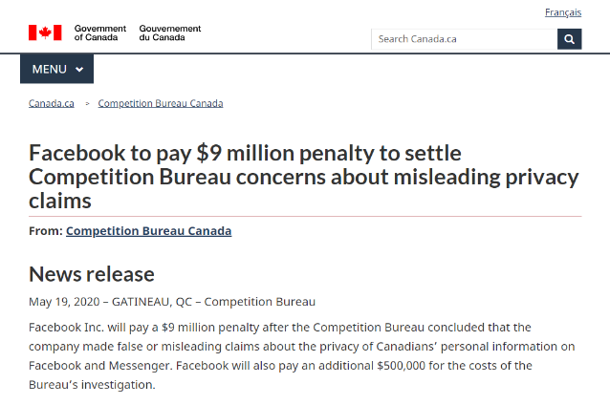

COMPETITION BUREAU
Facebook settlement
$9 million, $500,000 in costs

Slide 48


COMPETITION BUREAU
Impression that users could control who could see and access their personal information when using privacy features
  general “Privacy Settings” page, the “About” page, the audience selector menu on posts, among others
Do consumers really understand?
  what is happening with their data, collection how often, by whom, how it’s being used

Slide 49




Michael Binetti
mbinetti@agmlawyers.com
Lesley Fair
lfair@ftc.gov
George Lusty
george.lusty@cma.gov.uk
Nicola Pfeifer
Nicola.Pfeifer@canada.ca

