Slide 1




HOT TOPICS IN
CONSUMER PROTECTION ENFORCEMENT
a conversation with Canadian and U.S. law enforcers
Moderator:
Michael Binetti, Affleck Greene McMurtry LLP
Panelist:
Lawrence Zuker, Competition Bureau Canada
Panelist:
Lesley Fair, Federal Trade Commission

Slide 2
Lawrence Zuker
doesn’t speak forthe Competition Bureau.
And Lesley Fair doesn’t speak for the FTC.

Slide 3
THE Past
12 months

Slide 4





THE PAST 12 MONTHS
AT THE COMPETITION BUREAU
Weight loss claims must be true and supported by testing
The Bureau wants more competition in the wireless industry
Bureau obtains court order to advance investigation of Bell
Commissioner’s appointment
March
April
May
February
Hudson’s Bay paid $4.5 million AMP/costs to settle pricing case
Fraud Prevention Month
Josephine Palumbo, Deputy Commissioner assumes presidency of ICPEN in 2020

Slide 5
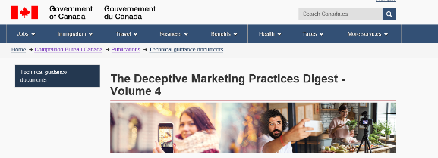
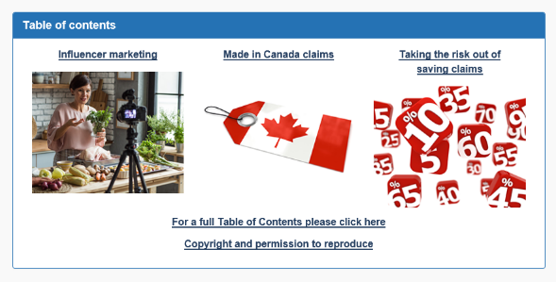
DECEPTIVE MARKETING PRACTICES DIGEST
Digest Vol. 4: www.competitionbureau.gc.ca/eic/site/cb-bc.nsf/eng/04372.html

Slide 6

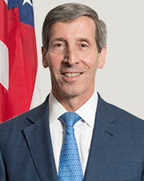
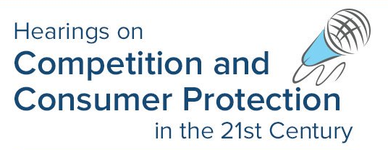



THE PAST 12 MONTHS
AT THE FEDERAL TRADE COMMISSION
Former FTC BC Director Joseph Simons sworn in as FTC Chairman
Consumer receive $505 million in refunds from FTC v. AMG payday lending case
Operation Main Street: civil and criminal actions against scammers targeting small business
FTC reaches its full complement of five Commissioners
FTC announces first five Consumer Review Fairness Act cases
May
June
July
September
October
May
June
Former BCP staffer Andrew Smith named Director of Bureau of Consumer Protection
FTC-DOJ Western Union team wins “Service to America” medal
Operation Donate with Honor: 100 partners crack down on bogus veterans’ charities
FTC convenes Hearings on Competition and Consumer Protection in the 21st Century
FTC’s fourth PrivacyCon

Slide 7
ADVERTISING
SUBSTANTIATION and
PERFORMANCE CLAIMS

Slide 8
FTC STANDARD
To substantiate health, safety, or efficacy claims, advertisers need “competent and reliable scientific evidence,” which, depending on the claim, may mean randomized clinical testing.

Slide 9

HEALTH CLAIMS
FTC v. Regenerative Medical Group (stipulated order)

Slide 10

HEALTH CLAIMS
In the Matter of iV Bars (consent order)

Slide 11

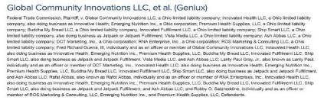
HEALTH CLAIMS and AD FORMAT

Slide 12
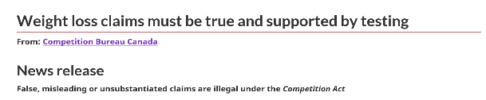
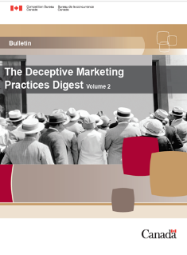
PERFORMANCE CLAIMS
Under the Competition Act, claims about the performance or efficacy of a product must be based on adequate and proper testing:
Testing must be conducted.
Ensure that any and all marketing materials do not create a false or misleading general impression.
Sellers and marketers of natural health products must also comply with the Food and Drugs Act.
www.canada.ca/en/competition-bureau/news/2019/02/weight-loss-claims-must-be-true-and-supported-by-testing-false-misleading-or-unsubstantiated-claims-are-illegal-under-the-competition-act.html

Slide 13
ORIGIN
CLAIMS

Slide 14


MADE IN CANADA
The Commissioner of Competition v. Moose International Inc.
Consent Agreement
https://www.ct-tc.gc.ca/CMFiles/CT 2016004_Registered%20Consent%20Agreement_20_66_12-7-2016_1503.pdf

Slide 15
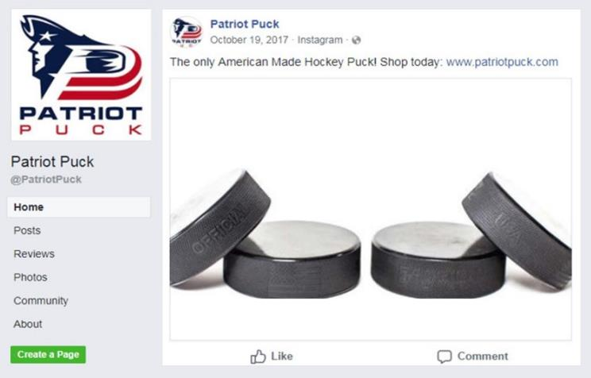
MADE IN USA
In the Matter of Patriot Puck (consent order)

Slide 16
SOCIAL MEDIA MARKETING

Slide 17
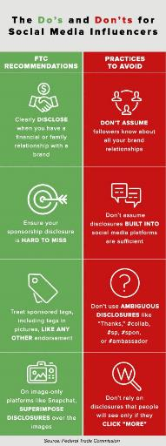
FTC STANDARD
If there’s a connection between the seller of the product and an endorser that might materially affect the weight or credibility of the endorsement, the connection must be fully disclosed.
Definition
“Endorser” includes blogger, tweeter, influencer, Instagrammer, etc.
Advertisers Educate your social media partners and monitor what they do on your behalf.
Influencers
Disclosure and truth in advertising standards apply to you, too.

Slide 18
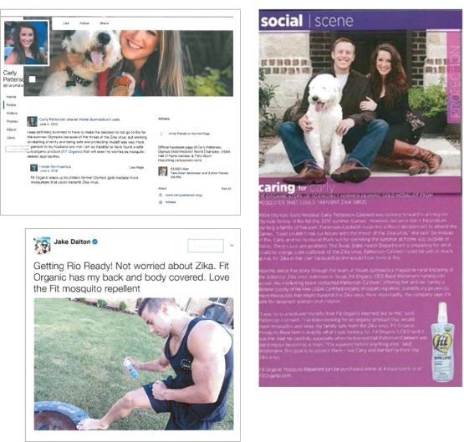
SOCIAL MEDIA INFLUENCERS
In the Matter of Creaxion Corporation and Inside Publications of Georgia (consent order)

Slide 19
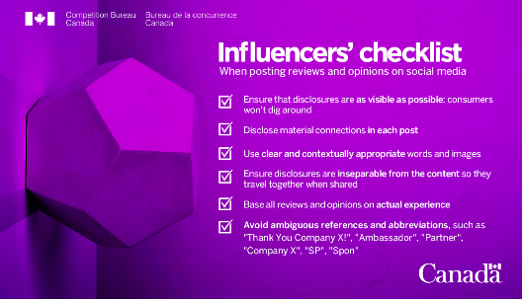
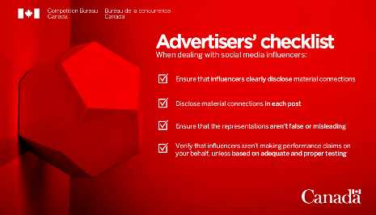
INFLUENCERS’ RESPONSIBILITIES
Deceptive Marketing Practices Digest: Volume
www.competitionbureau.gc.ca/eic/site/cb-bc.nsf/eng/04372.html

Slide 20
ONLINE CONSUMER REVIEWS

Slide 21
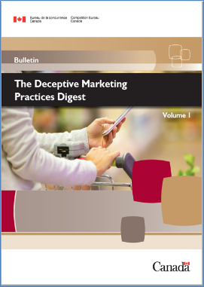

ONLINE REVIEWS
The Bureau provided guidance for online reviews in the first volume of the Deceptive Marketing Practices Digest
The Bureau also worked with ICPEN to issue guidance on online reviews and endorsements: www.icpen.org/initiatives#industry-guidance

Slide 22
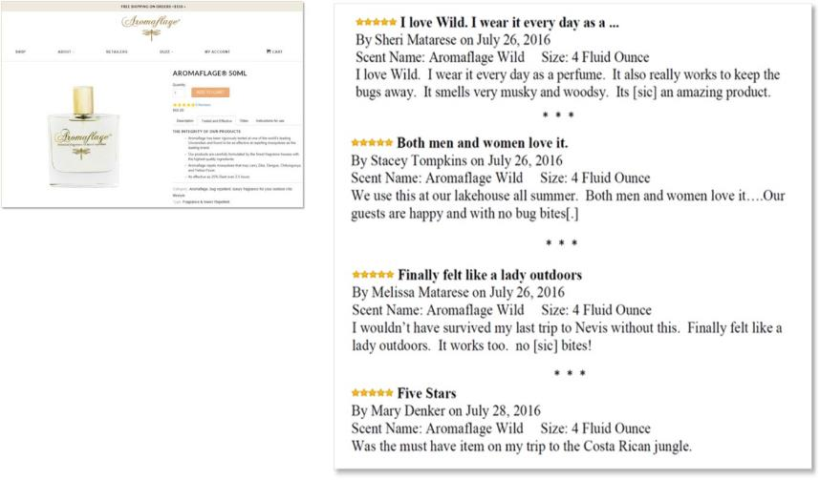
DISCLOSE MATERIAL CONNECTIONS
In the Matter of Mikey and Momo, Inc. (Aromaflage) (consent order)

Slide 23

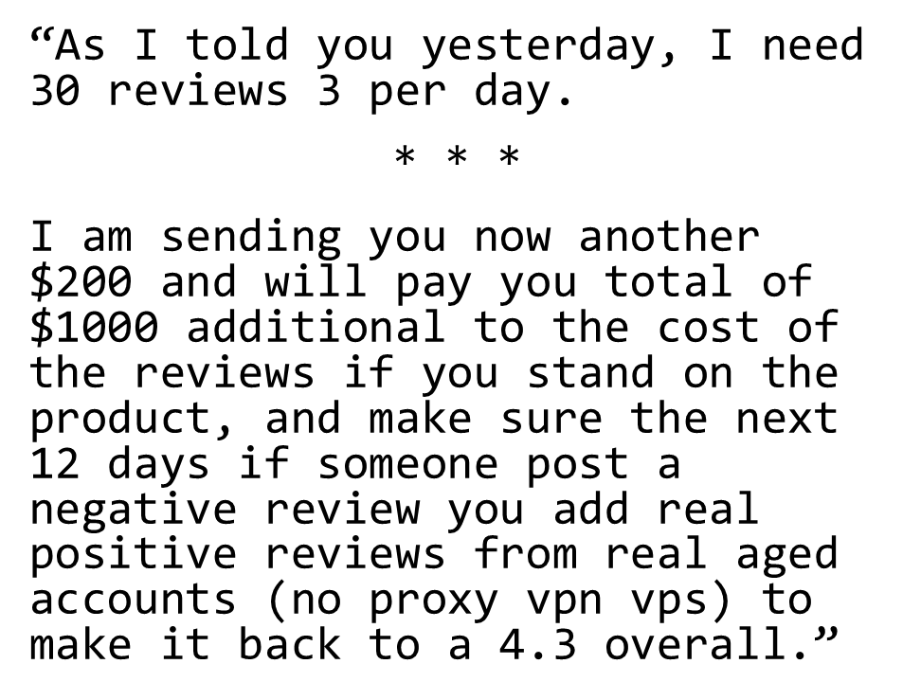
PAID-FOR “REVIEWS”
FTC v. Cure Encapsulations, Inc. (stipulated order)

Slide 24


Consumer
Review
Fairness
Act
CRFA prohibits contract terms that:
restrict consumers’ ability to review a company’s products, services, conduct;
impose a penalty against a consumer who gives a review; or
require consumers to give up intellectual property rights in the content of their reviews.

Slide 25
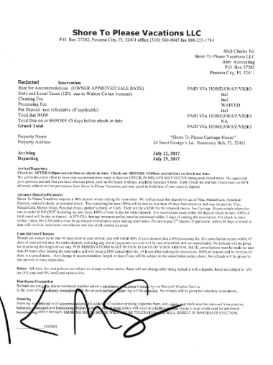
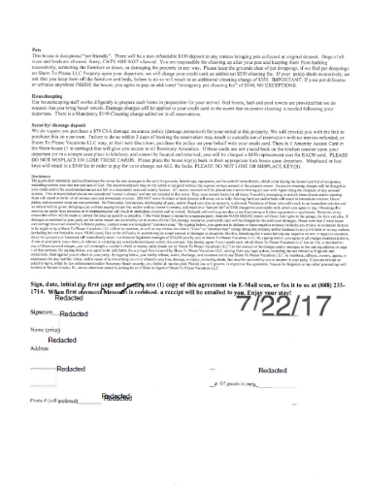
CRFA LAW ENFORCEMENT
By signing below, you agree not to defame or leave negative reviews (includes any review or comment deemed to be negative by a Shore to Please Vacations LLC officer or member, as well as any review less than a “5 star” or “absolute best” rating) about this property and/or business in any print form or on any website . . . Due to the difficulty in ascertaining an actual amount of damages in situations like this, breaching this clause . . . will immediately result in minimum liquidated damages of $25,000 paid by you to Shore to Please Vacations LLC.
In the Matter of Shore to Please Vacations LLC (proposed consent order)

Slide 26
PRICING CLAIMS and FINANCIAL DECEPTION

Slide 27

ORDINARY SELLING PRICE
2017: Allegations by Competition Bureau
Agreed to pay $4.5 million Administrative Monetary Penalty (AMP)/costs
Binding for 10 years
for sleep sets and major appliances
May 2019: Signed a Consent Agreement

Slide 28
TIPS FOR PRICING REPRESENTATIONS
Don’t rely on prices provided by your suppliers without independently confirming what regular prices are prevailing for the product or like products in the relevant market.
The Reasonable Period of Time of the Volume Test (1 year) may be shorter depending on the nature of the product. (e.g. seasonal products like Christmas trees)
The Substantial Period of Time of the Time Test (6-months) may be shorter depending on the nature of the product.
Don’t refer to clearance prices (sales) if you keep ordering the products.
Track your sales at regular prices; if you don’t sell significant quantities at regular prices, this may well be an indication that the market is not validating your regular prices. – Remember the good faith requirement of the OSP provision.
Don’t attract consumers with a low initial price offer and then add on supplemental costs.
If you are advertising a product/service at a certain price, consumers should be able to purchase that product/service at that advertised price + plus applicable taxes.
Don’t set your regular prices based on foreign competitive price analysis.
Don’t rely on small print to tack on additional costs to the price advertised; disclaimers or small print should not contradict the literal or general impression created by the initial price representation.
Don’t set and forget your regular prices.

Slide 29

DRIP PRICING
“Drip pricing” is a marketing practice in which firms advertise only part of a product’s price as the headline price and then reveal other charges or fees, usually mandatory or unavoidable fees, later as the customer goes through the buying process.
Examples of Consent Agreements:
Enterprise
Avis, Budget
Hertz/Dollar Thrifty
Discount
January 2018 the Bureau formally took action against Ticketmaster
Still ongoing

Slide 30


FINTECH
The term FinTech can apply to any innovation for how people transact business, from the invention of digital money to double-entry bookkeeping
The Bureau made 30 recommendations on how to promote greater competition and innovation in financial services primarily in three service categories
Retail
payments
Lending and
equity crowdfunding
Investment dealing and advice

Slide 31


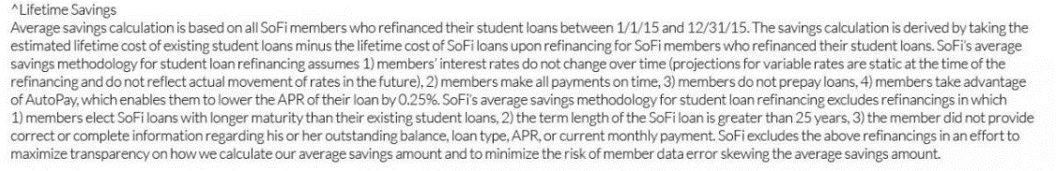
FINTECH
In the Matter of Social Finance, Inc. and Sofi Lending Corp. (consent order)

Slide 32
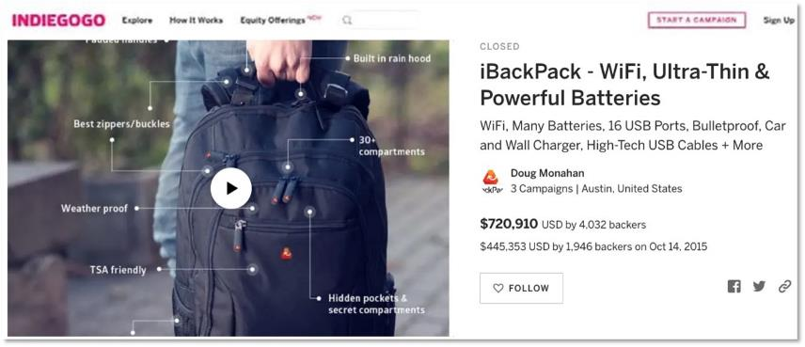
CROWDFUNDING PLATFORMS
FTC v. iBackPack Of Texas, LLC, and Douglas Monahan (complaint filed)

Slide 33
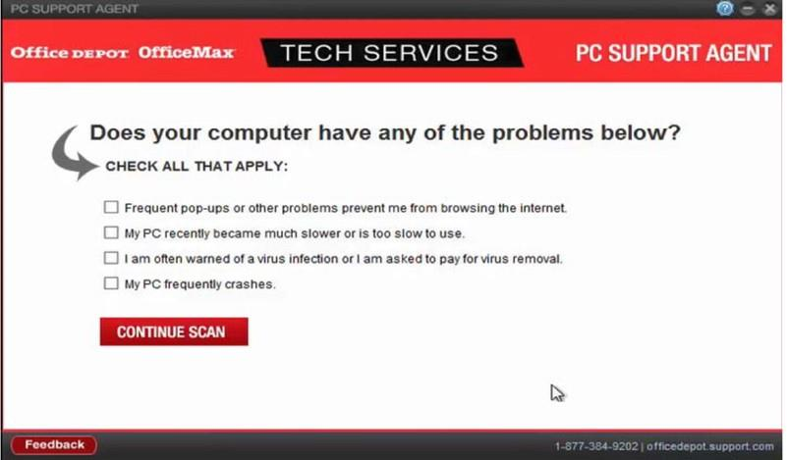
FINANCIAL DECEPTION
FTC v. Office Depot, Inc., and Support.com, Inc. (stipulated order)

Slide 34
Restore
Online
Shoppers’
Confidence
Act
ROSCA bans online negative options unless the seller:
clearly discloses all material terms of the deal before obtaining a consumer’s billing information;
gets consumer’s express informed consent before making the charge; and
provides a simple mechanism for stopping recurring charges.

Slide 35


ROSCA ENFORCEMENT
In the Matter of UrthBox, Inc. (consent order)

Slide 36
CONSUMER PRIVACY and DATA SECURITY

Slide 37
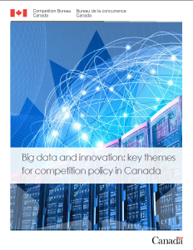

BIG DATA
The Data Forum: Four panels
Keeping Pace with Digital Platforms: The Role of Antitrust;
Privacy and Competition: The Boundaries;
Data Probability and Interoperability: The Future;
The Regularity and Enforcement Landscape.
www.competitionbureau.gc.ca/eic/site/cb-bc.nsf/vwapj/CB-Report-BigData-Eng.pdf/$file/CB-Report-BigData-Eng.pdf

Slide 38

FTC CONSUMER PRIVACY CASES

Slide 39

FTC DATA SECURITY CASES

Slide 40

FTC CHILDREN’S PRIVACY CASES

Slide 41
Cross-Border INITIATIVES

Slide 42
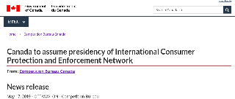


CROSS-BORDER COLLABORATION
The Bureau will focus on promoting truth in advertising online and building consumer confidence in the digital economy.
GPEN was formed in June 2007;
and became an observer member of ICPEN in 2017.
International collaboration enhances our enforcement efforts and promotes global policy convergence: www.competitionbureau.gc.ca/eic/site/cb-bc.nsf/eng/04205.html

Slide 43
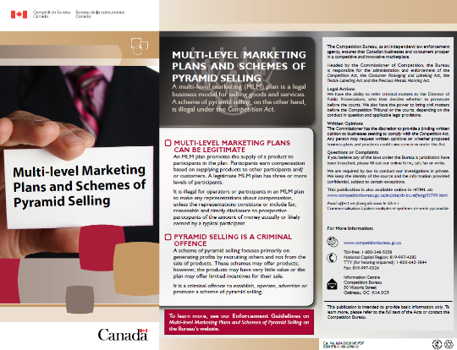
MULTI-LEVEL MARKETING
We have a WRITTEN OPINION program.
For question on the program or for more information on multi-level marketing:
See our website for Guidelines; or
Call 819-997-4282

Slide 44

GUIDANCE FOR SMALL BUSINESS
For more info: www.competitionbureau.gc.ca/eic/site/cb-bc.nsf/vwapj/cb-bulletin-corp-compliance-e.pdf/$FILE/cb-bulletin-corp-compliance-e.pdf

Slide 45

CROSS-BORDER DECEPTION

Slide 46
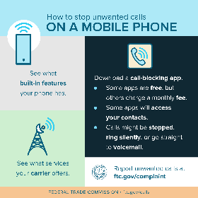
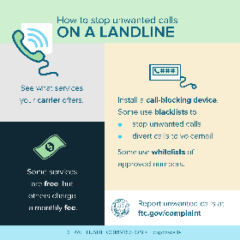
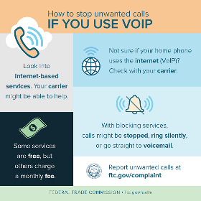
CROSS-BORDER COOPERATION

Slide 47
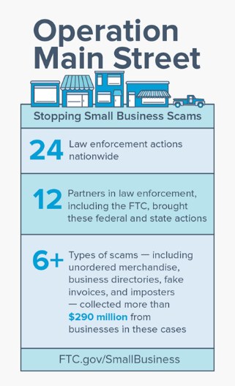

GUIDANCE FOR SMALL BUSINESS

Slide 48
FOR MORE INFORMATION

Slide 49
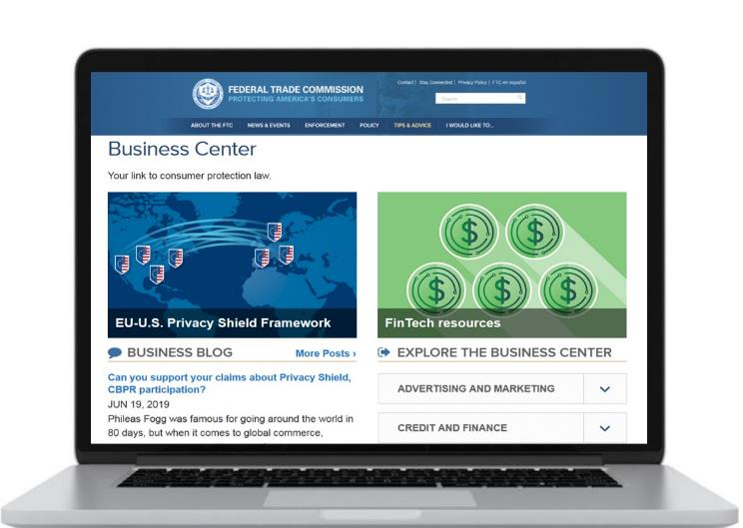
business.ftc.gov
ftc.gov/subscribe

Slide 50
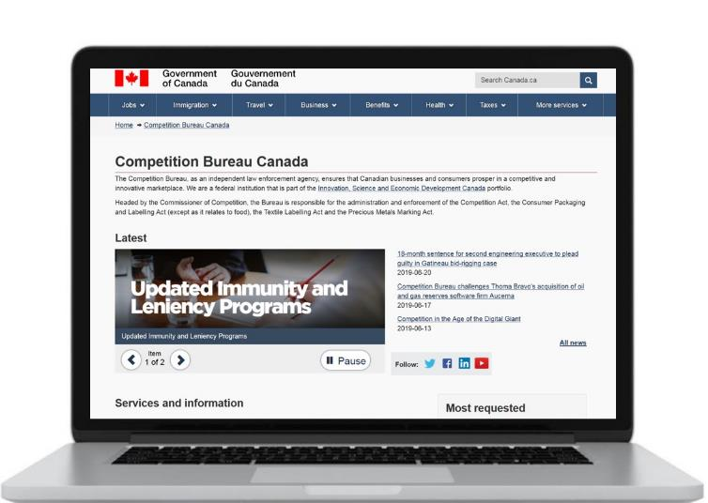
Competitionbureau.gc.ca
Bureaudelaconcurrance.gc.ca

Slide 51


mbinetti@agmlawyers.com
lawrence.zuker2@canada.ca
lfair@ftc.gov

